Slide 1


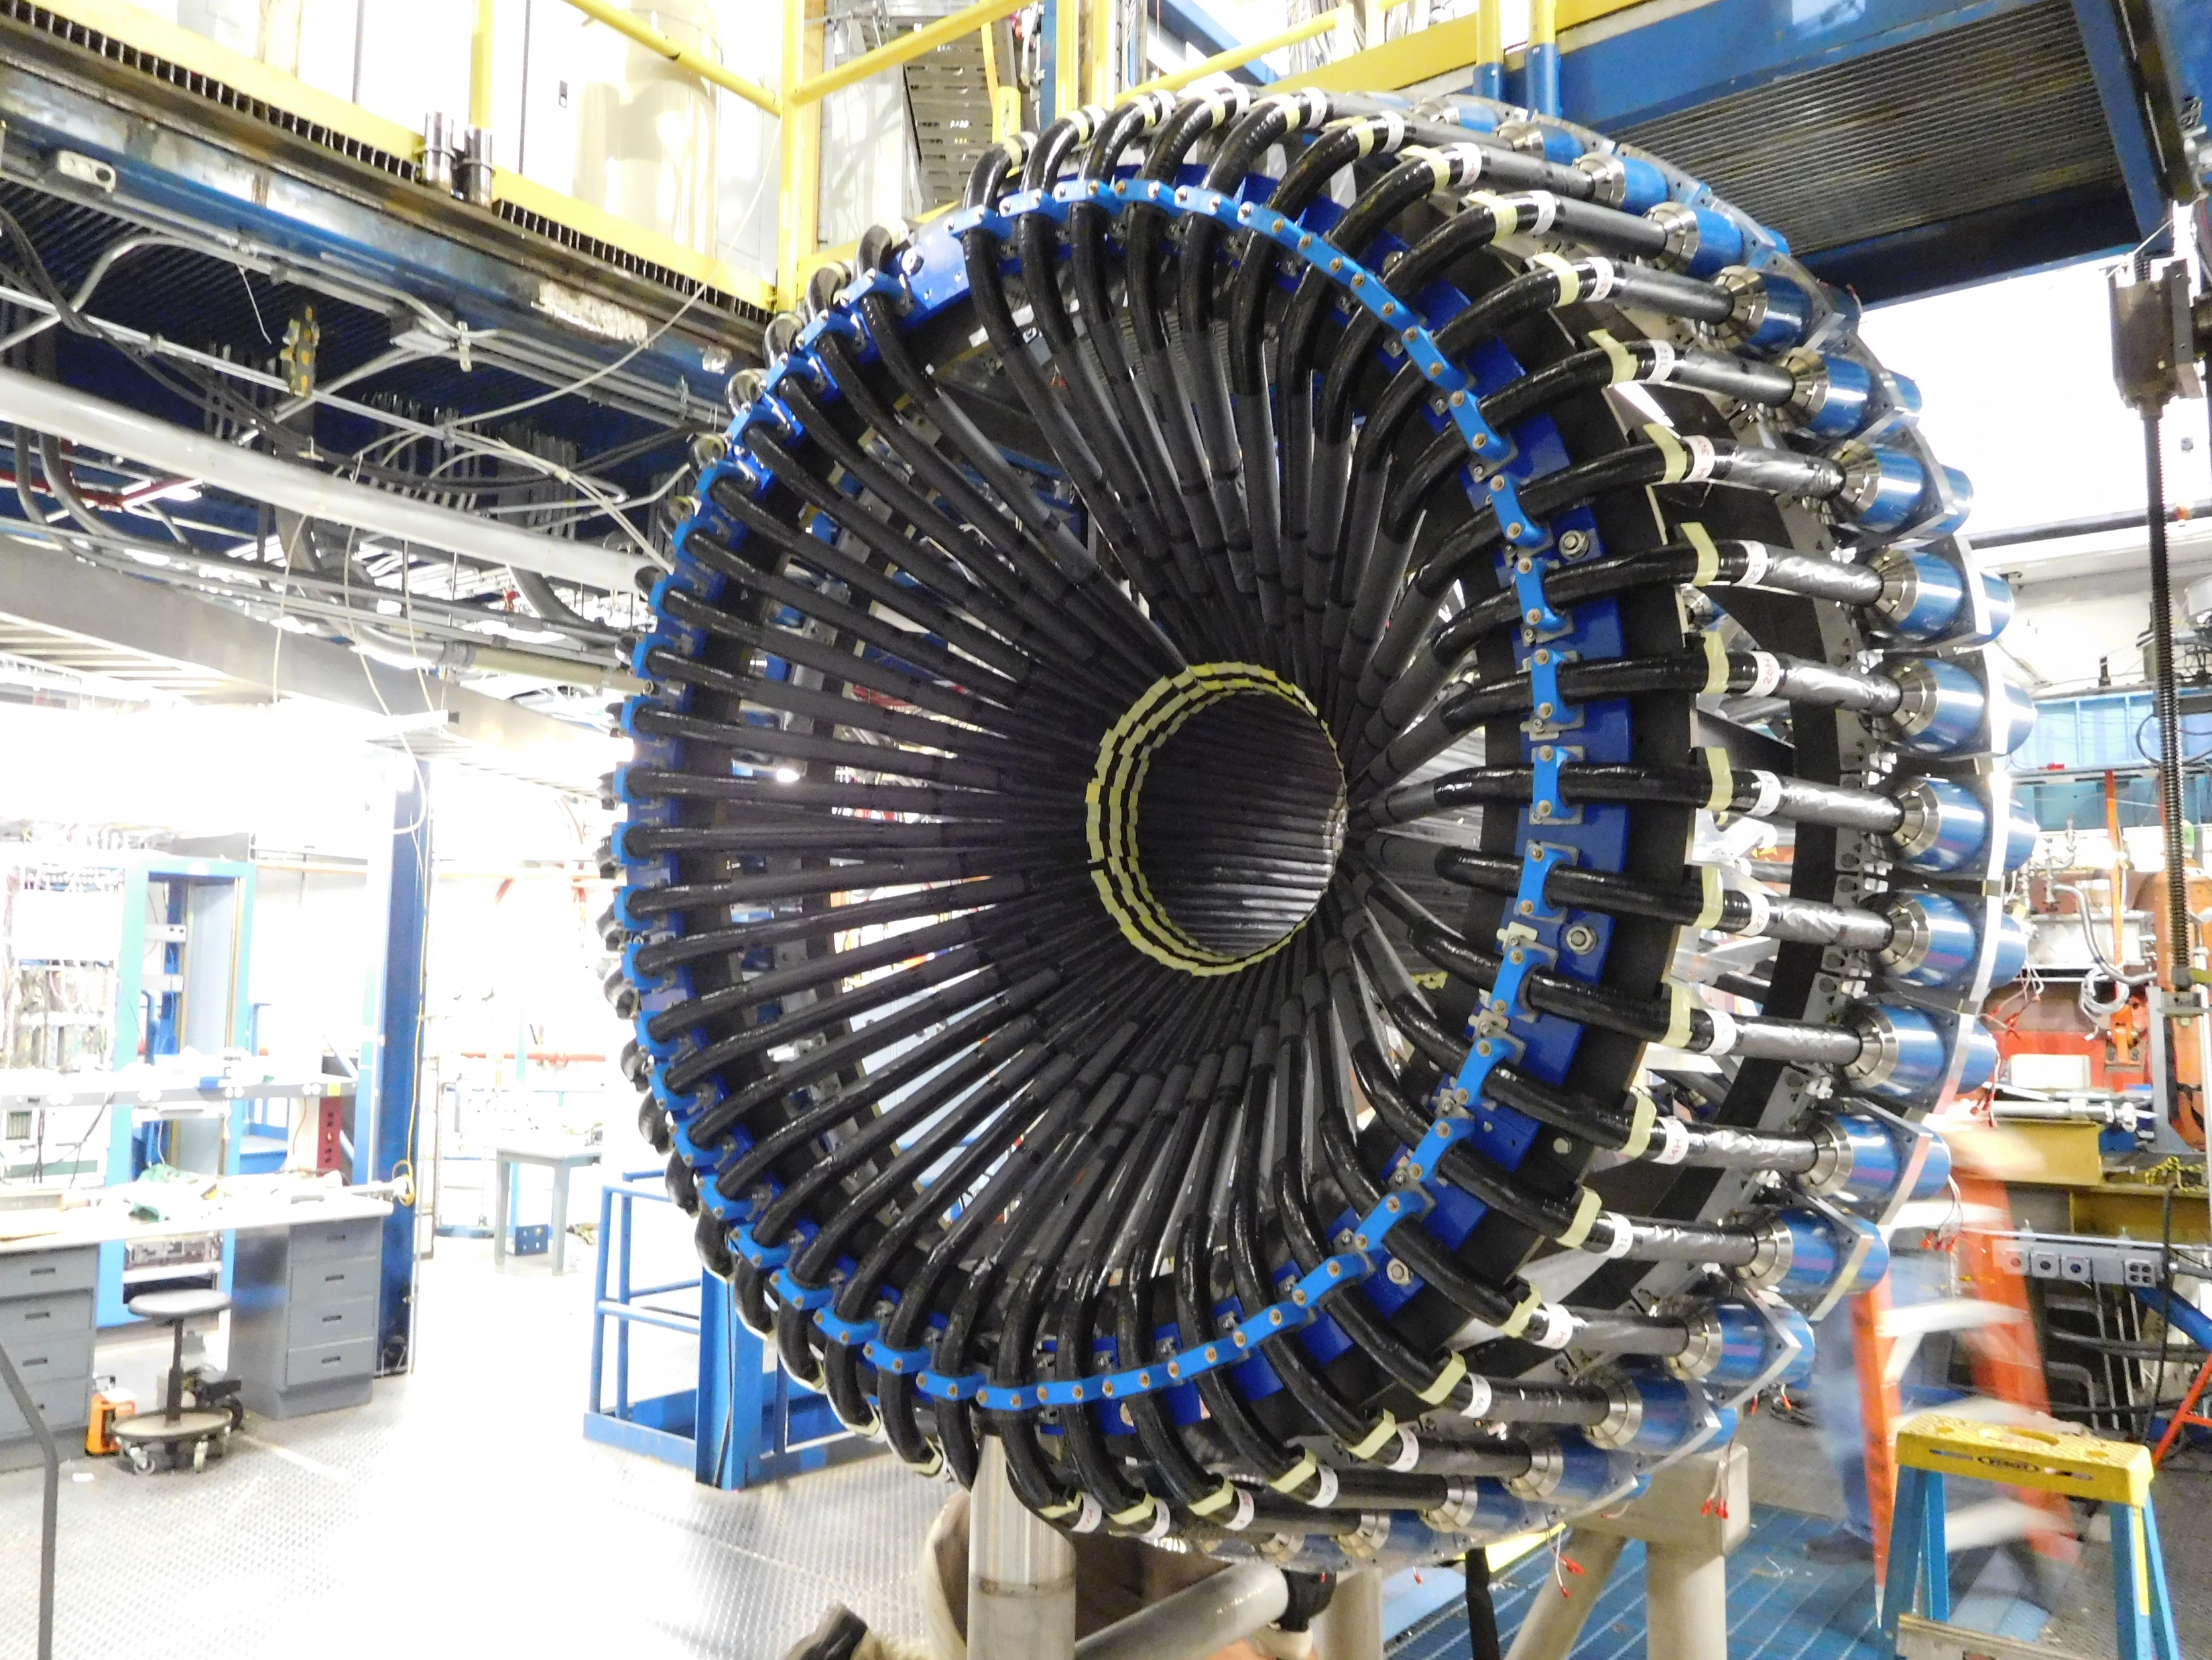

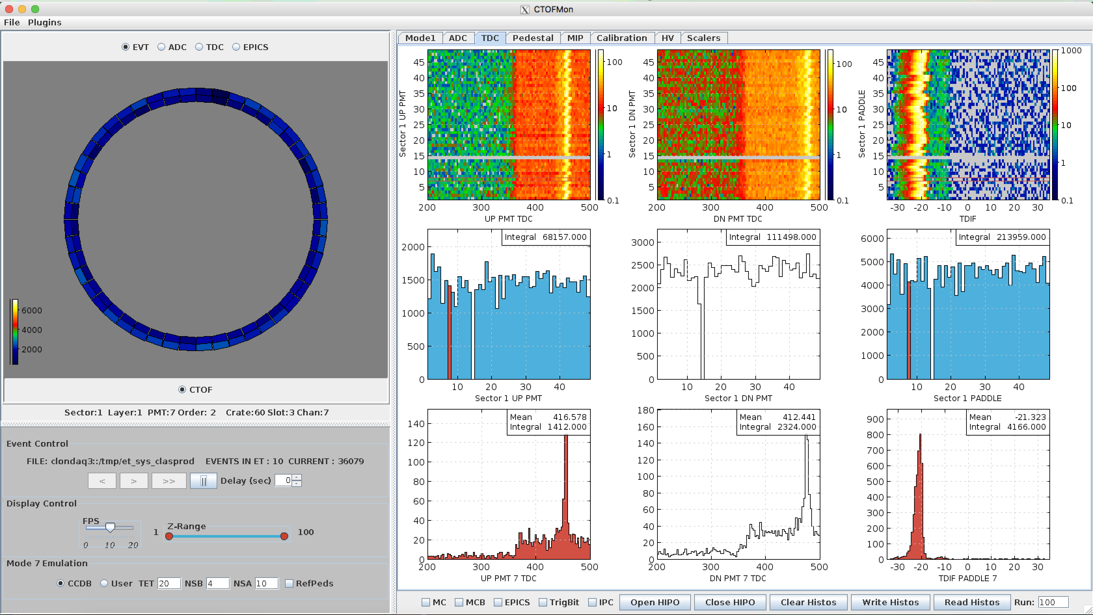
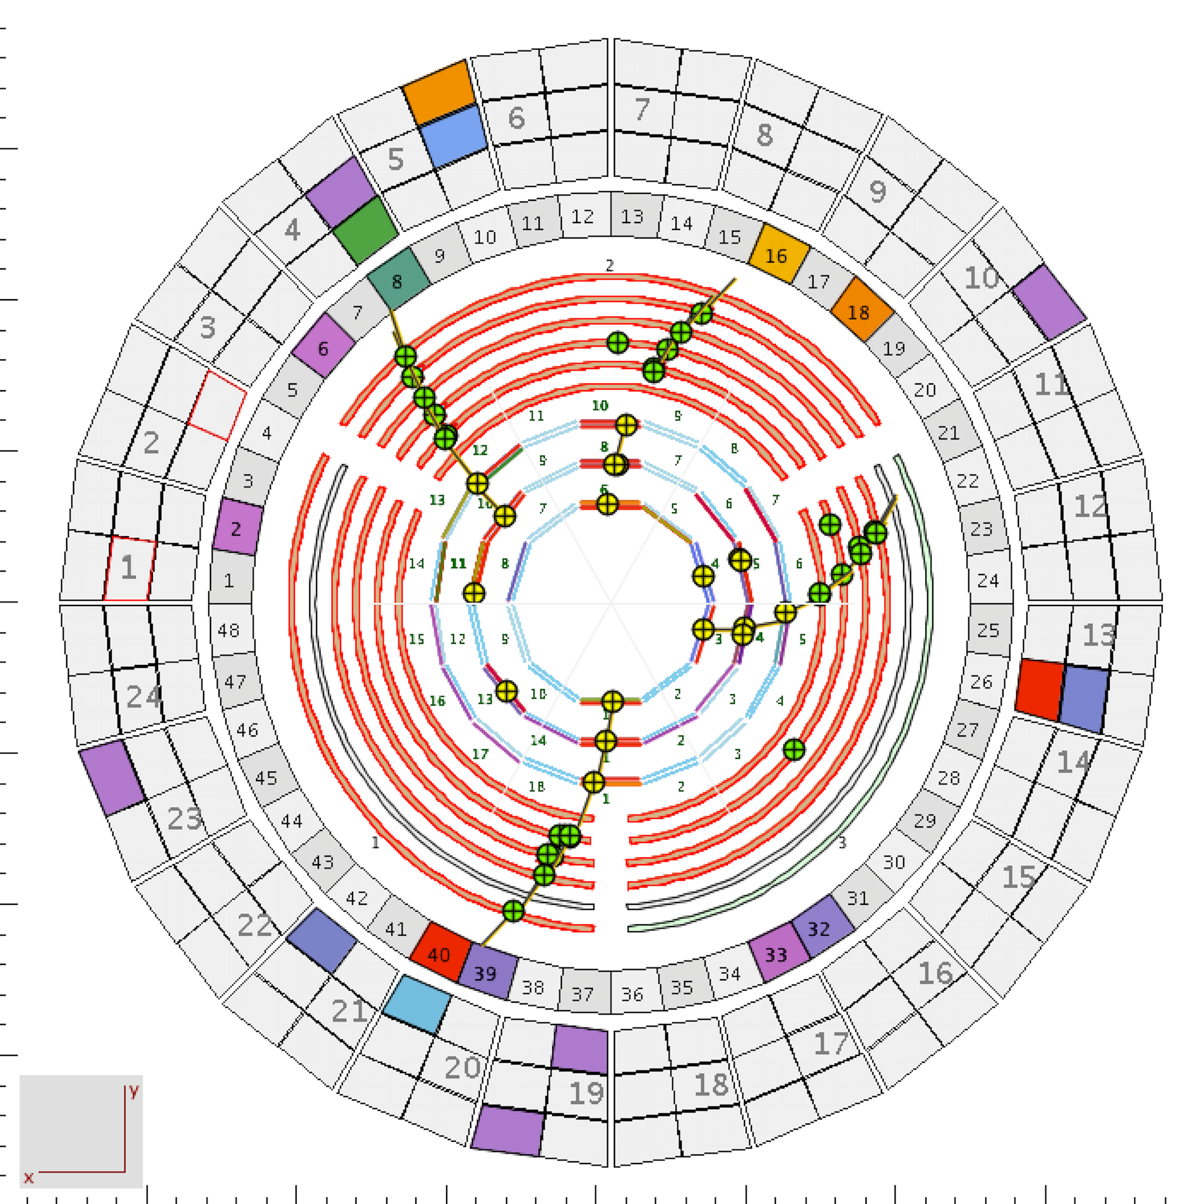
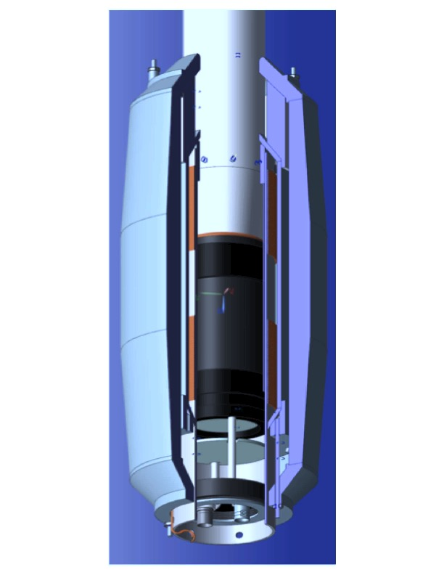
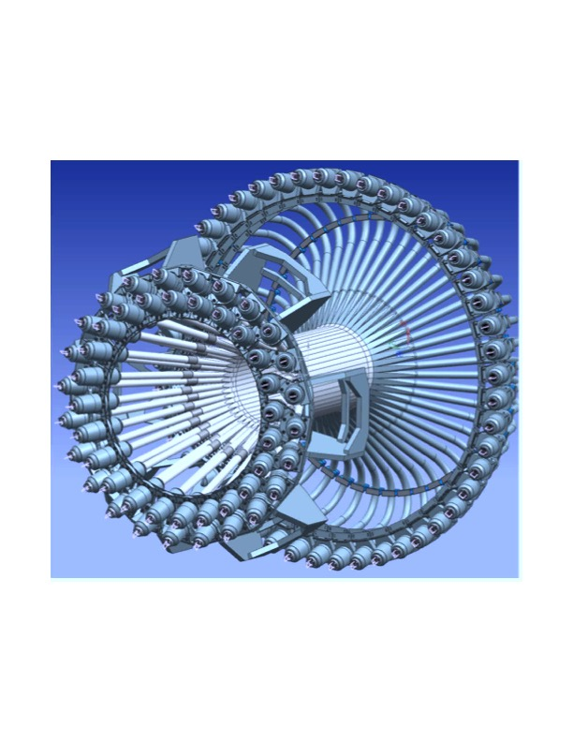
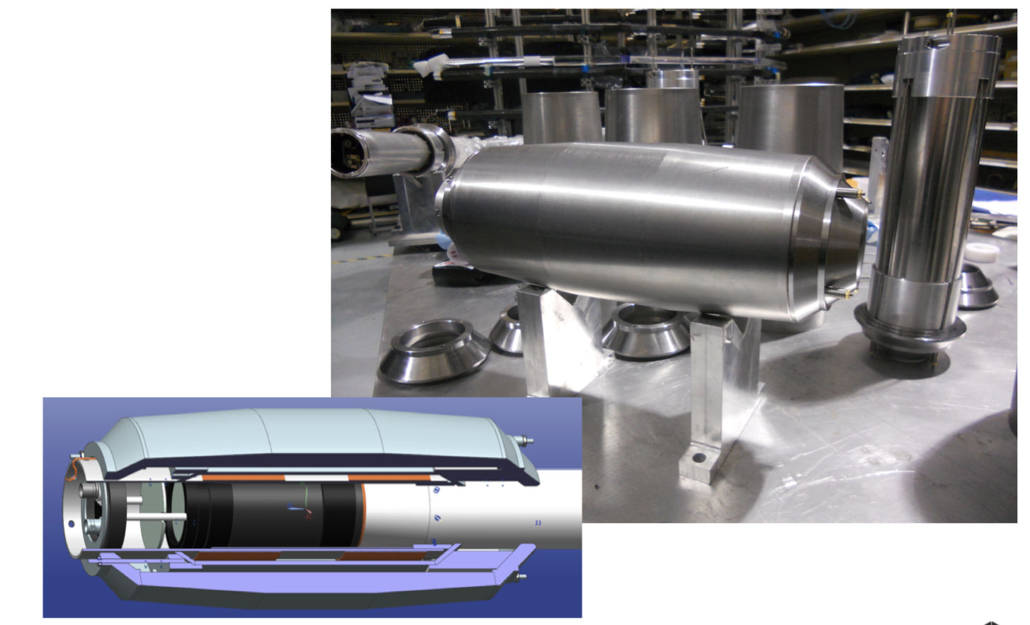
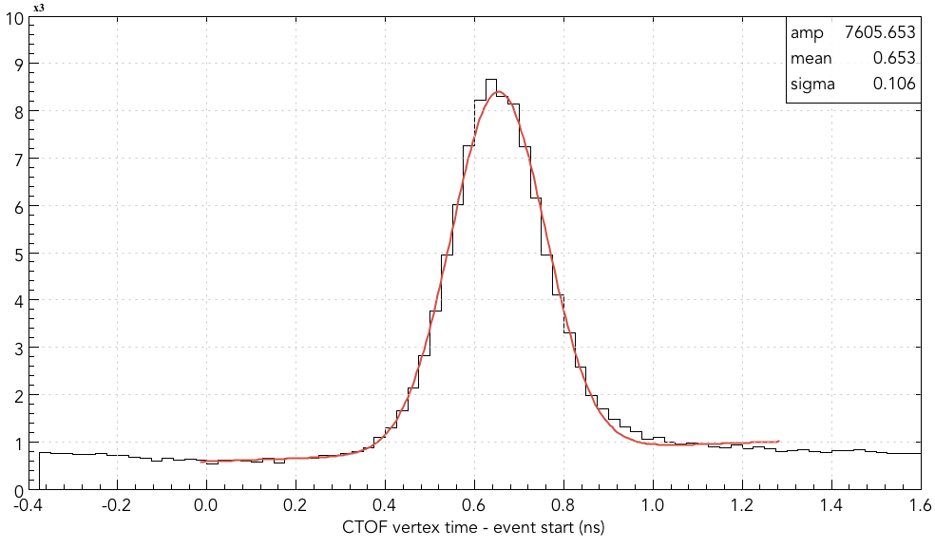
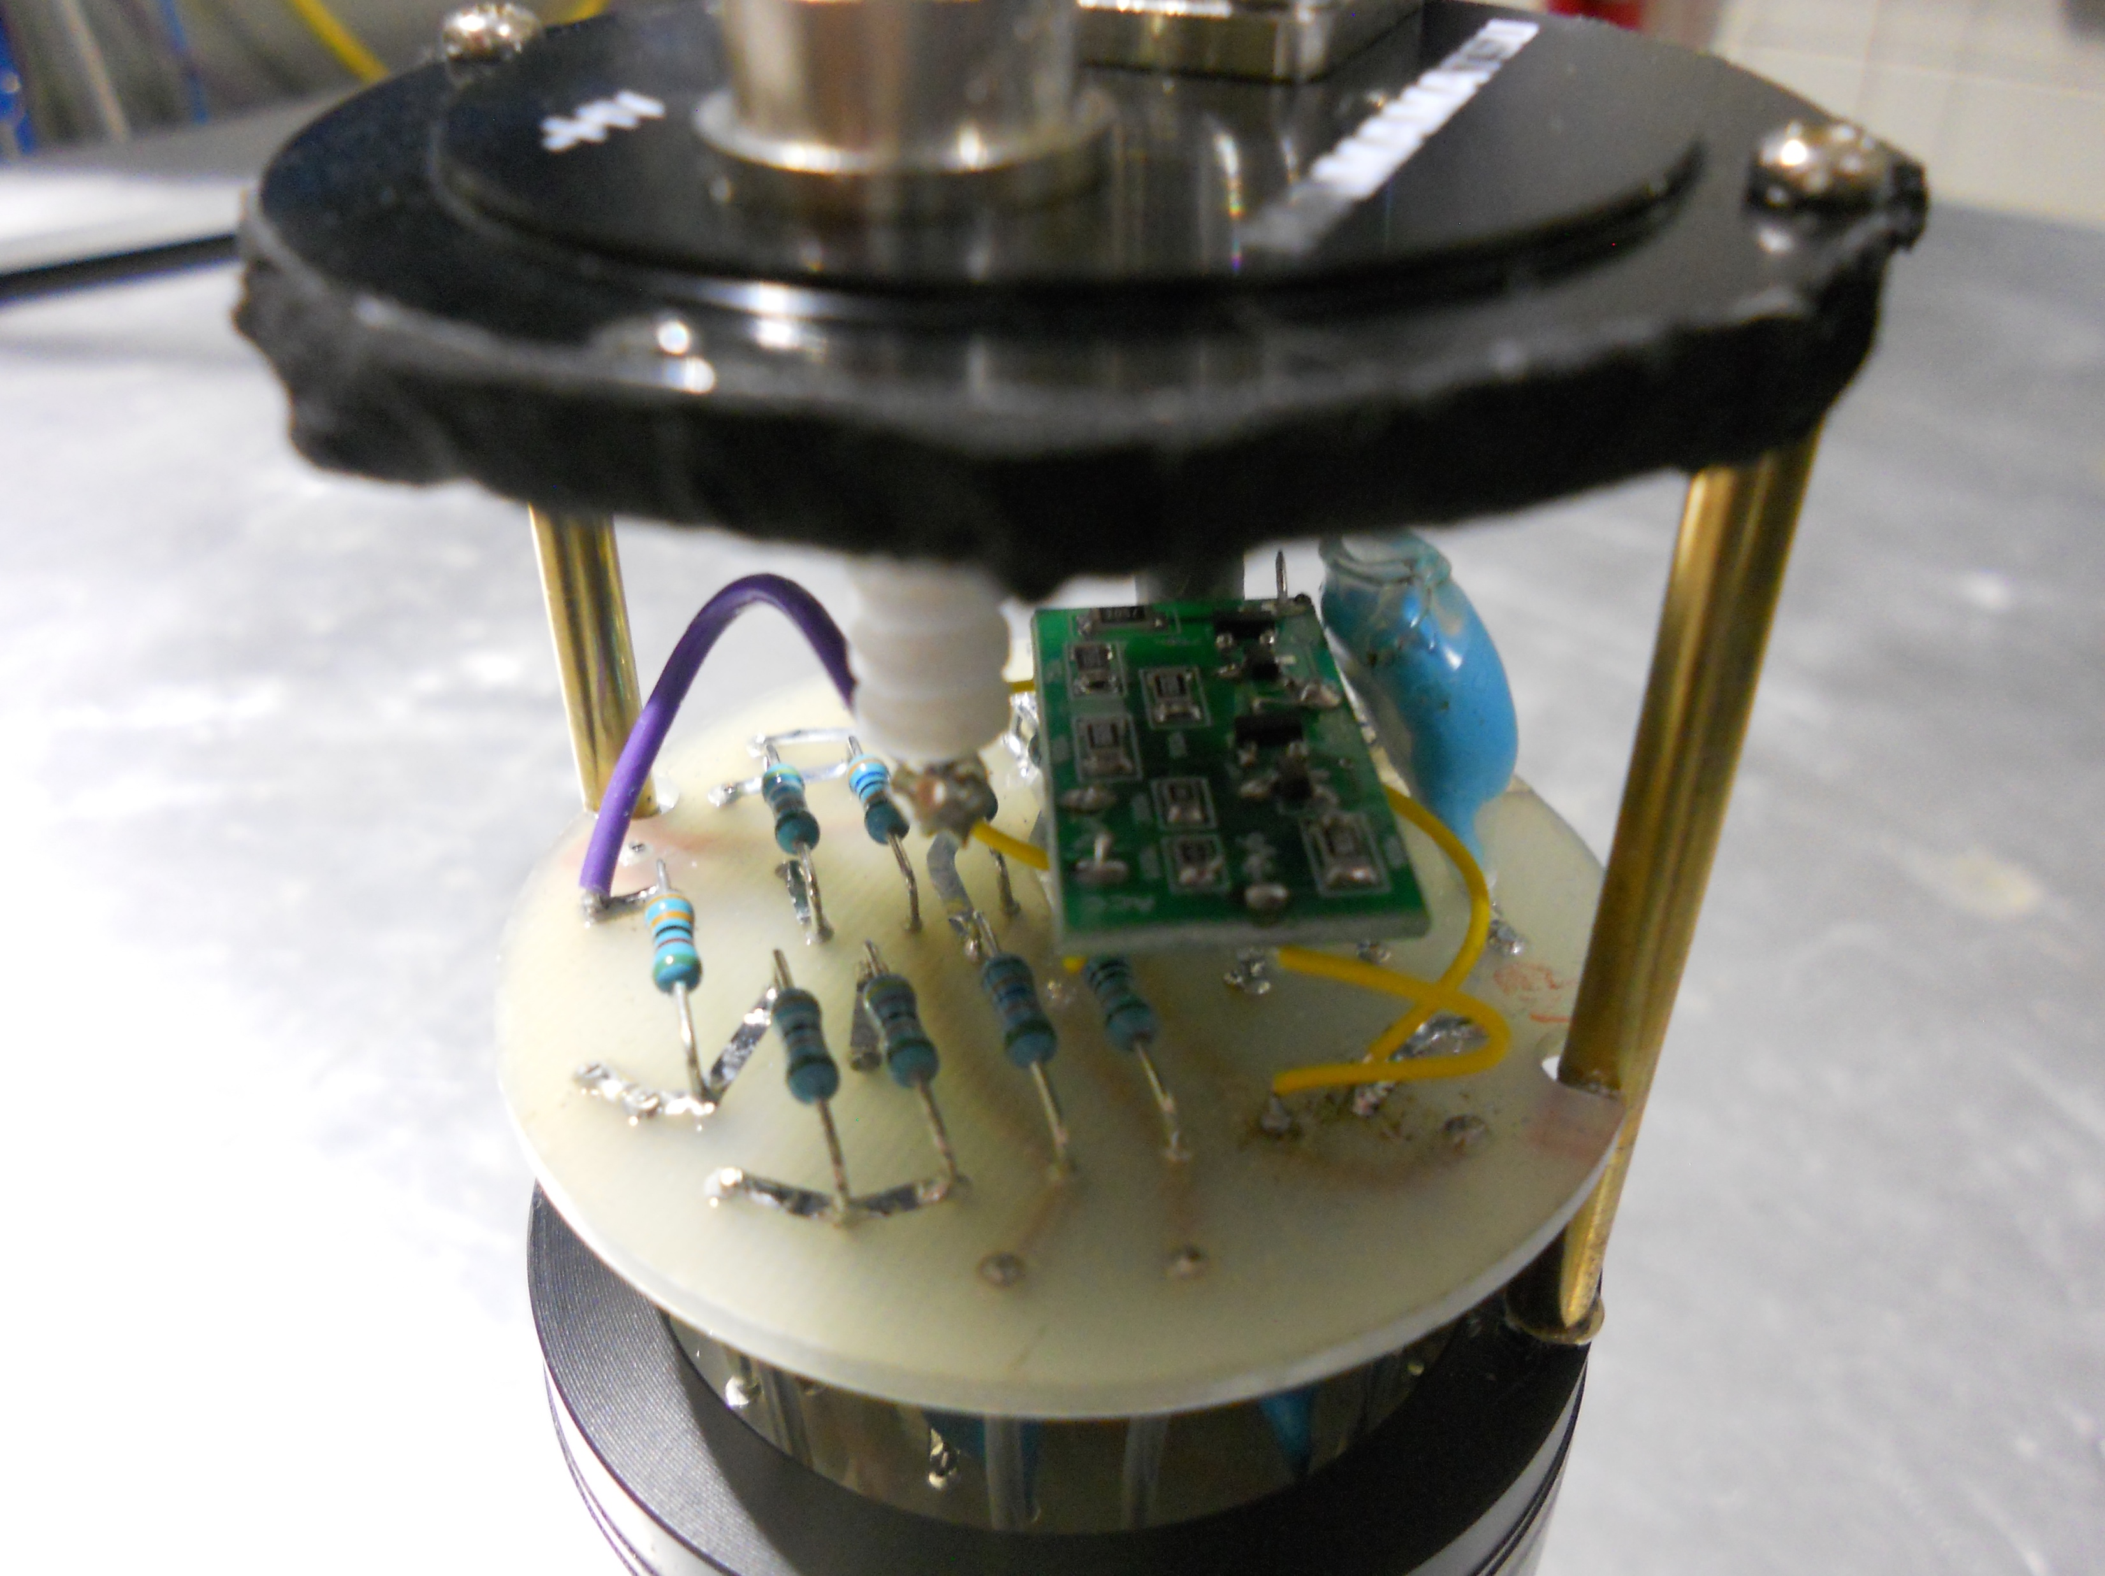
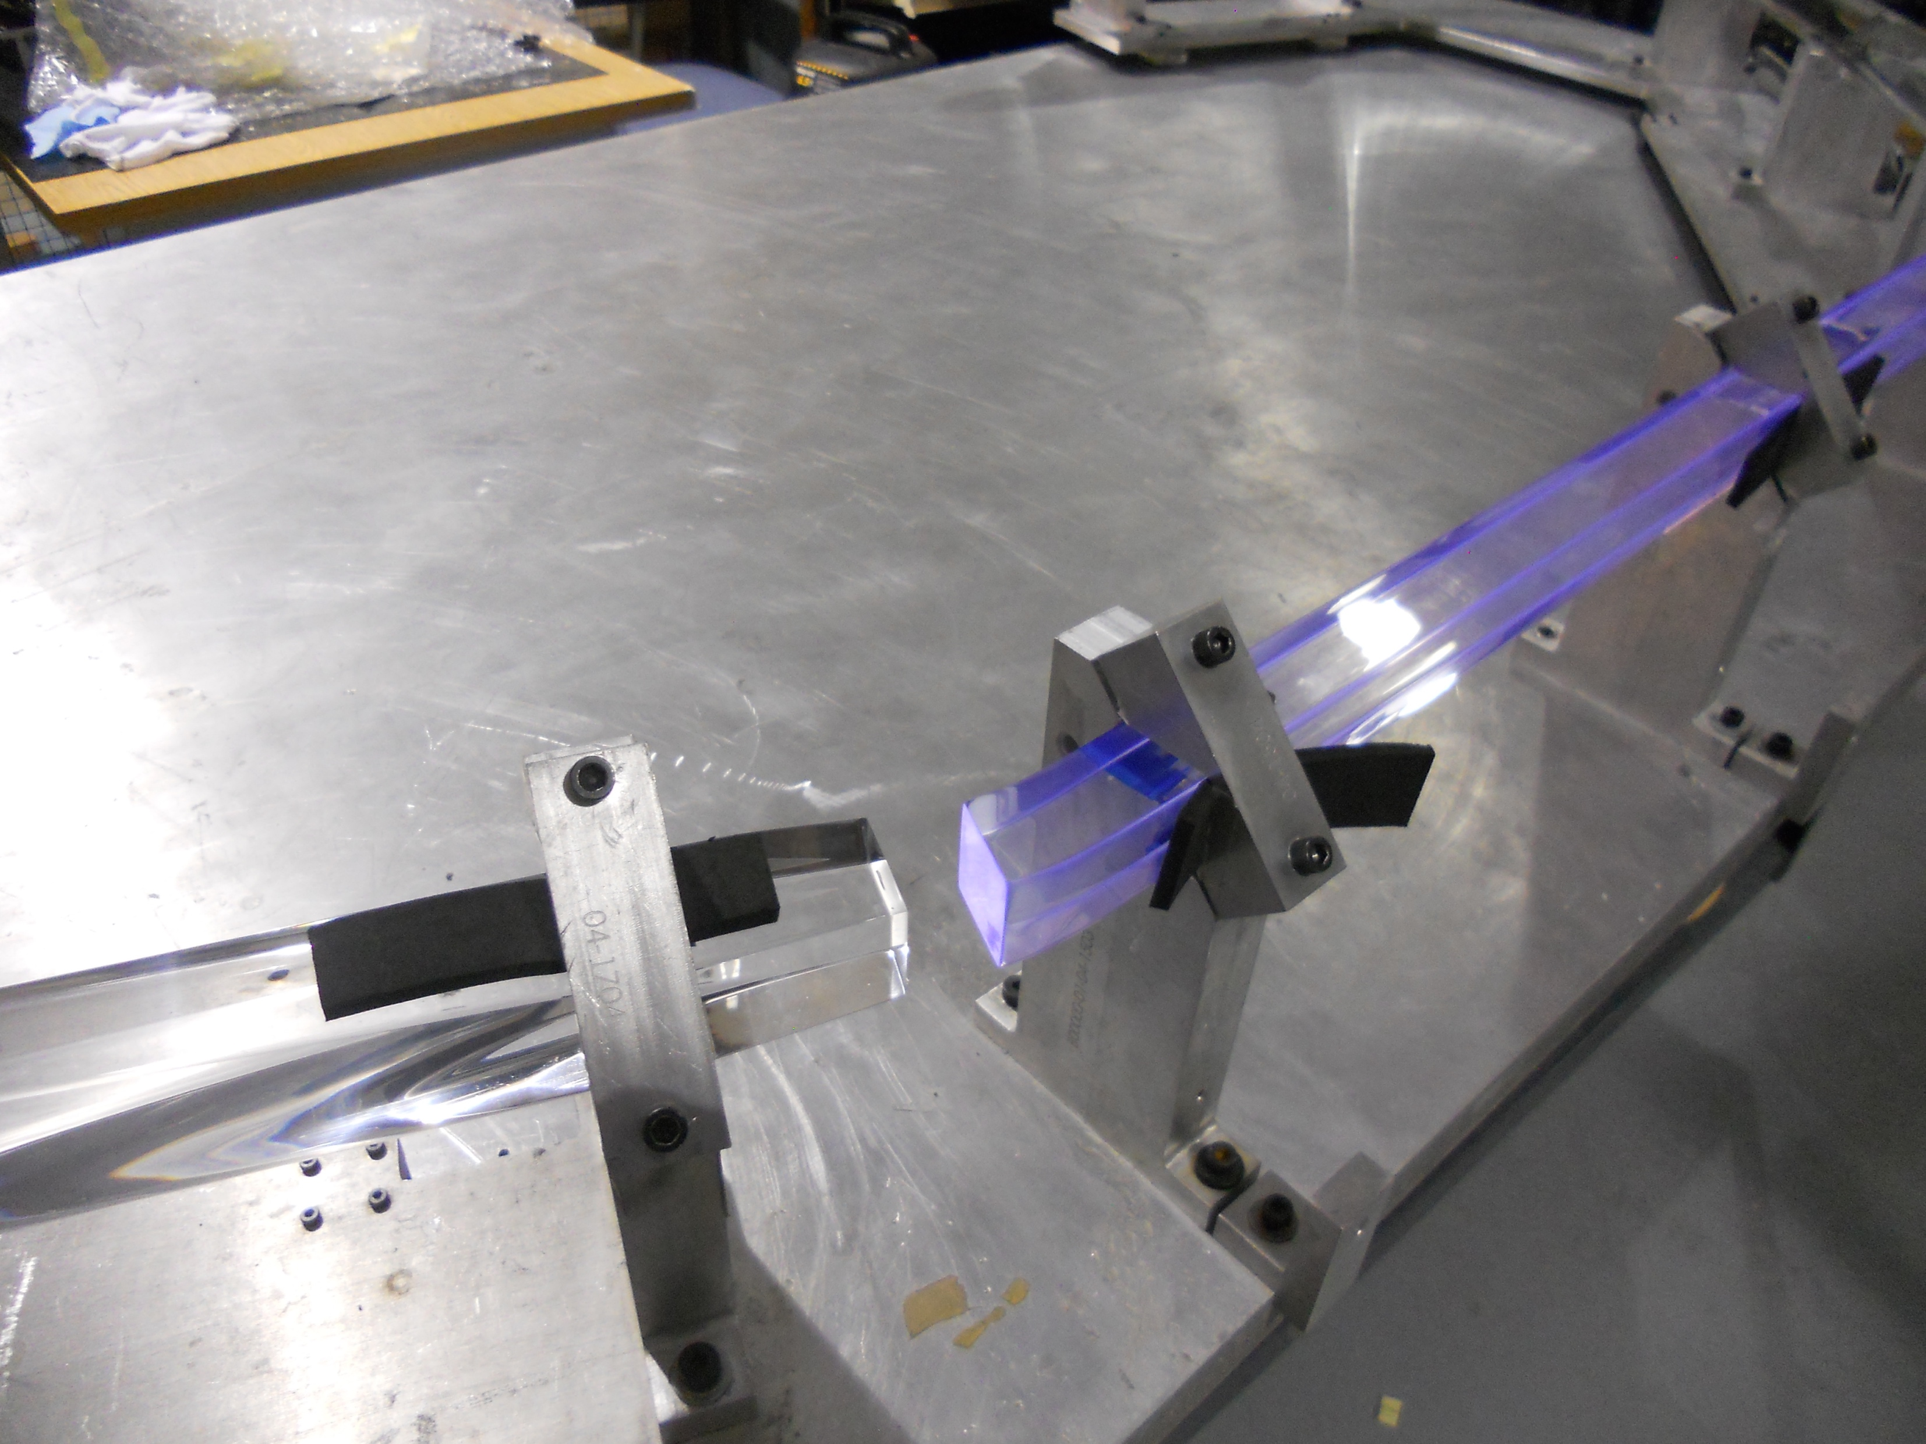
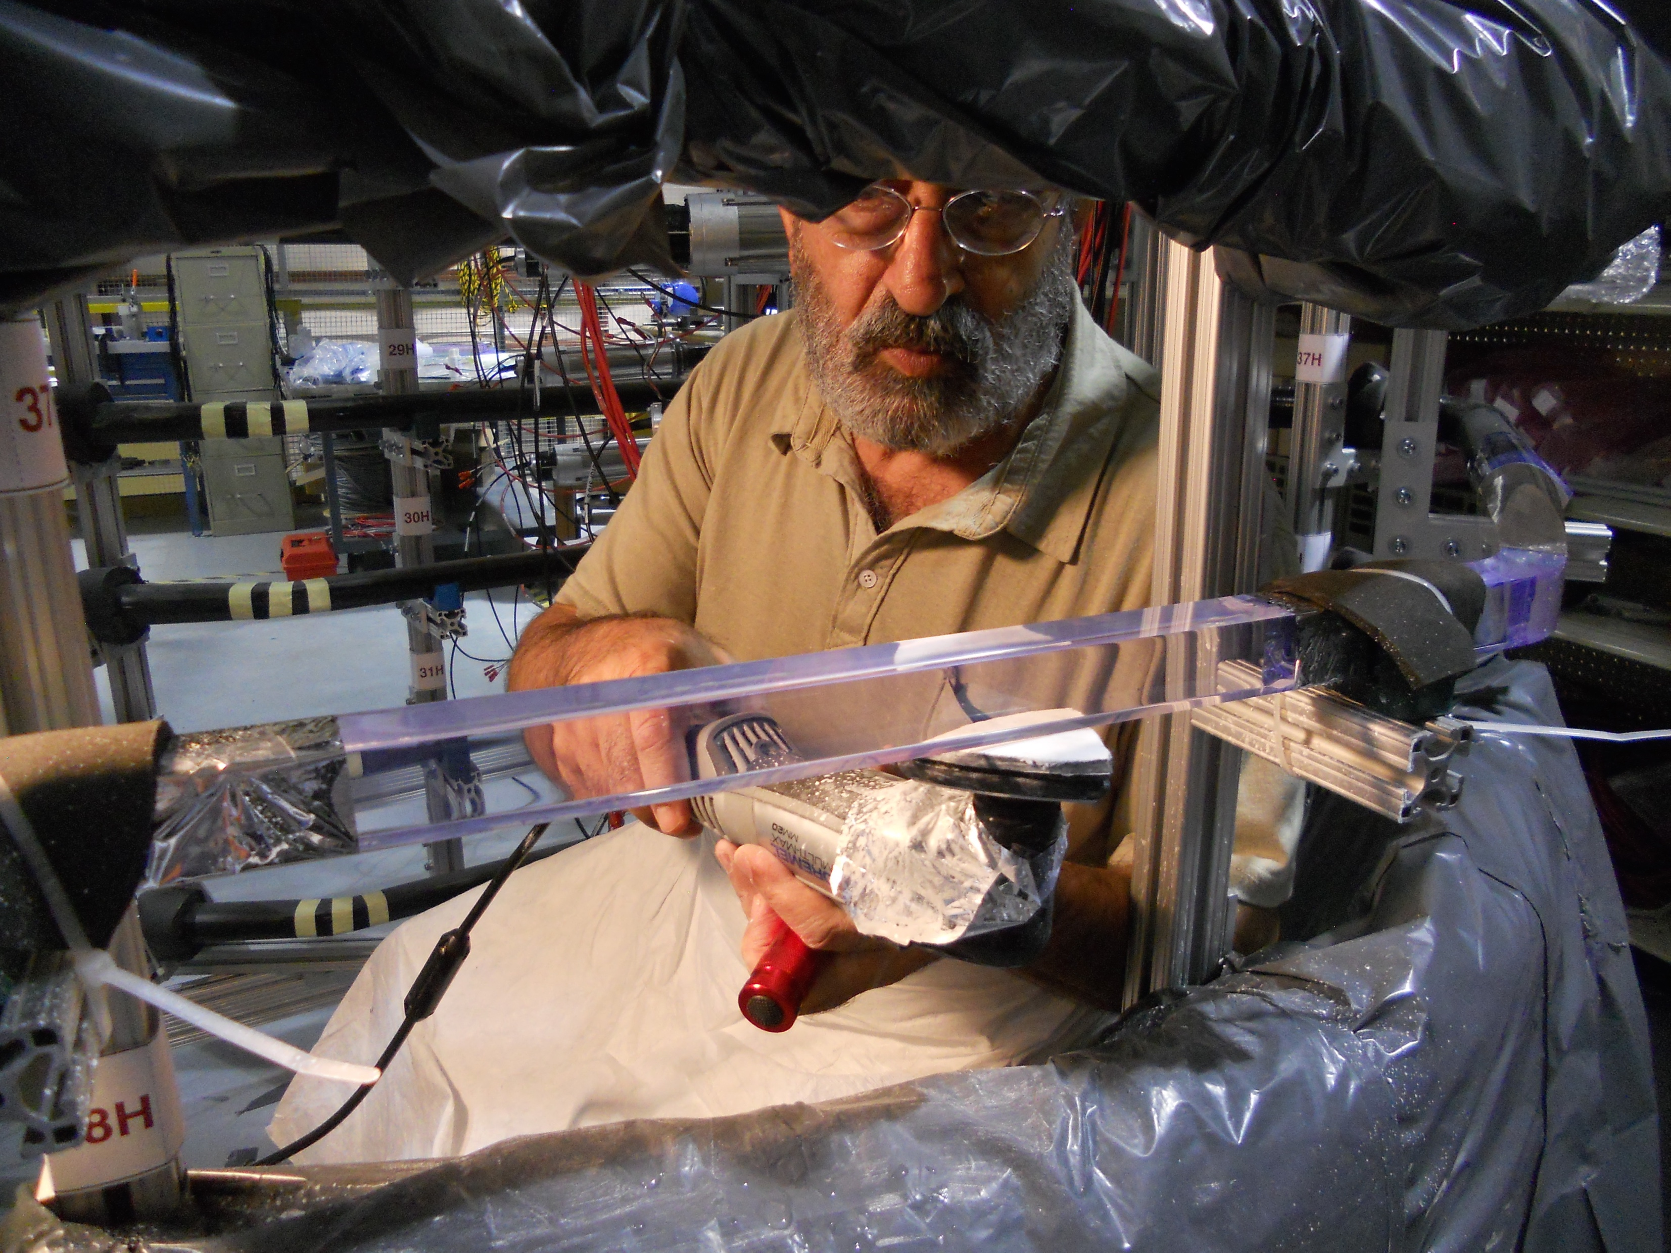
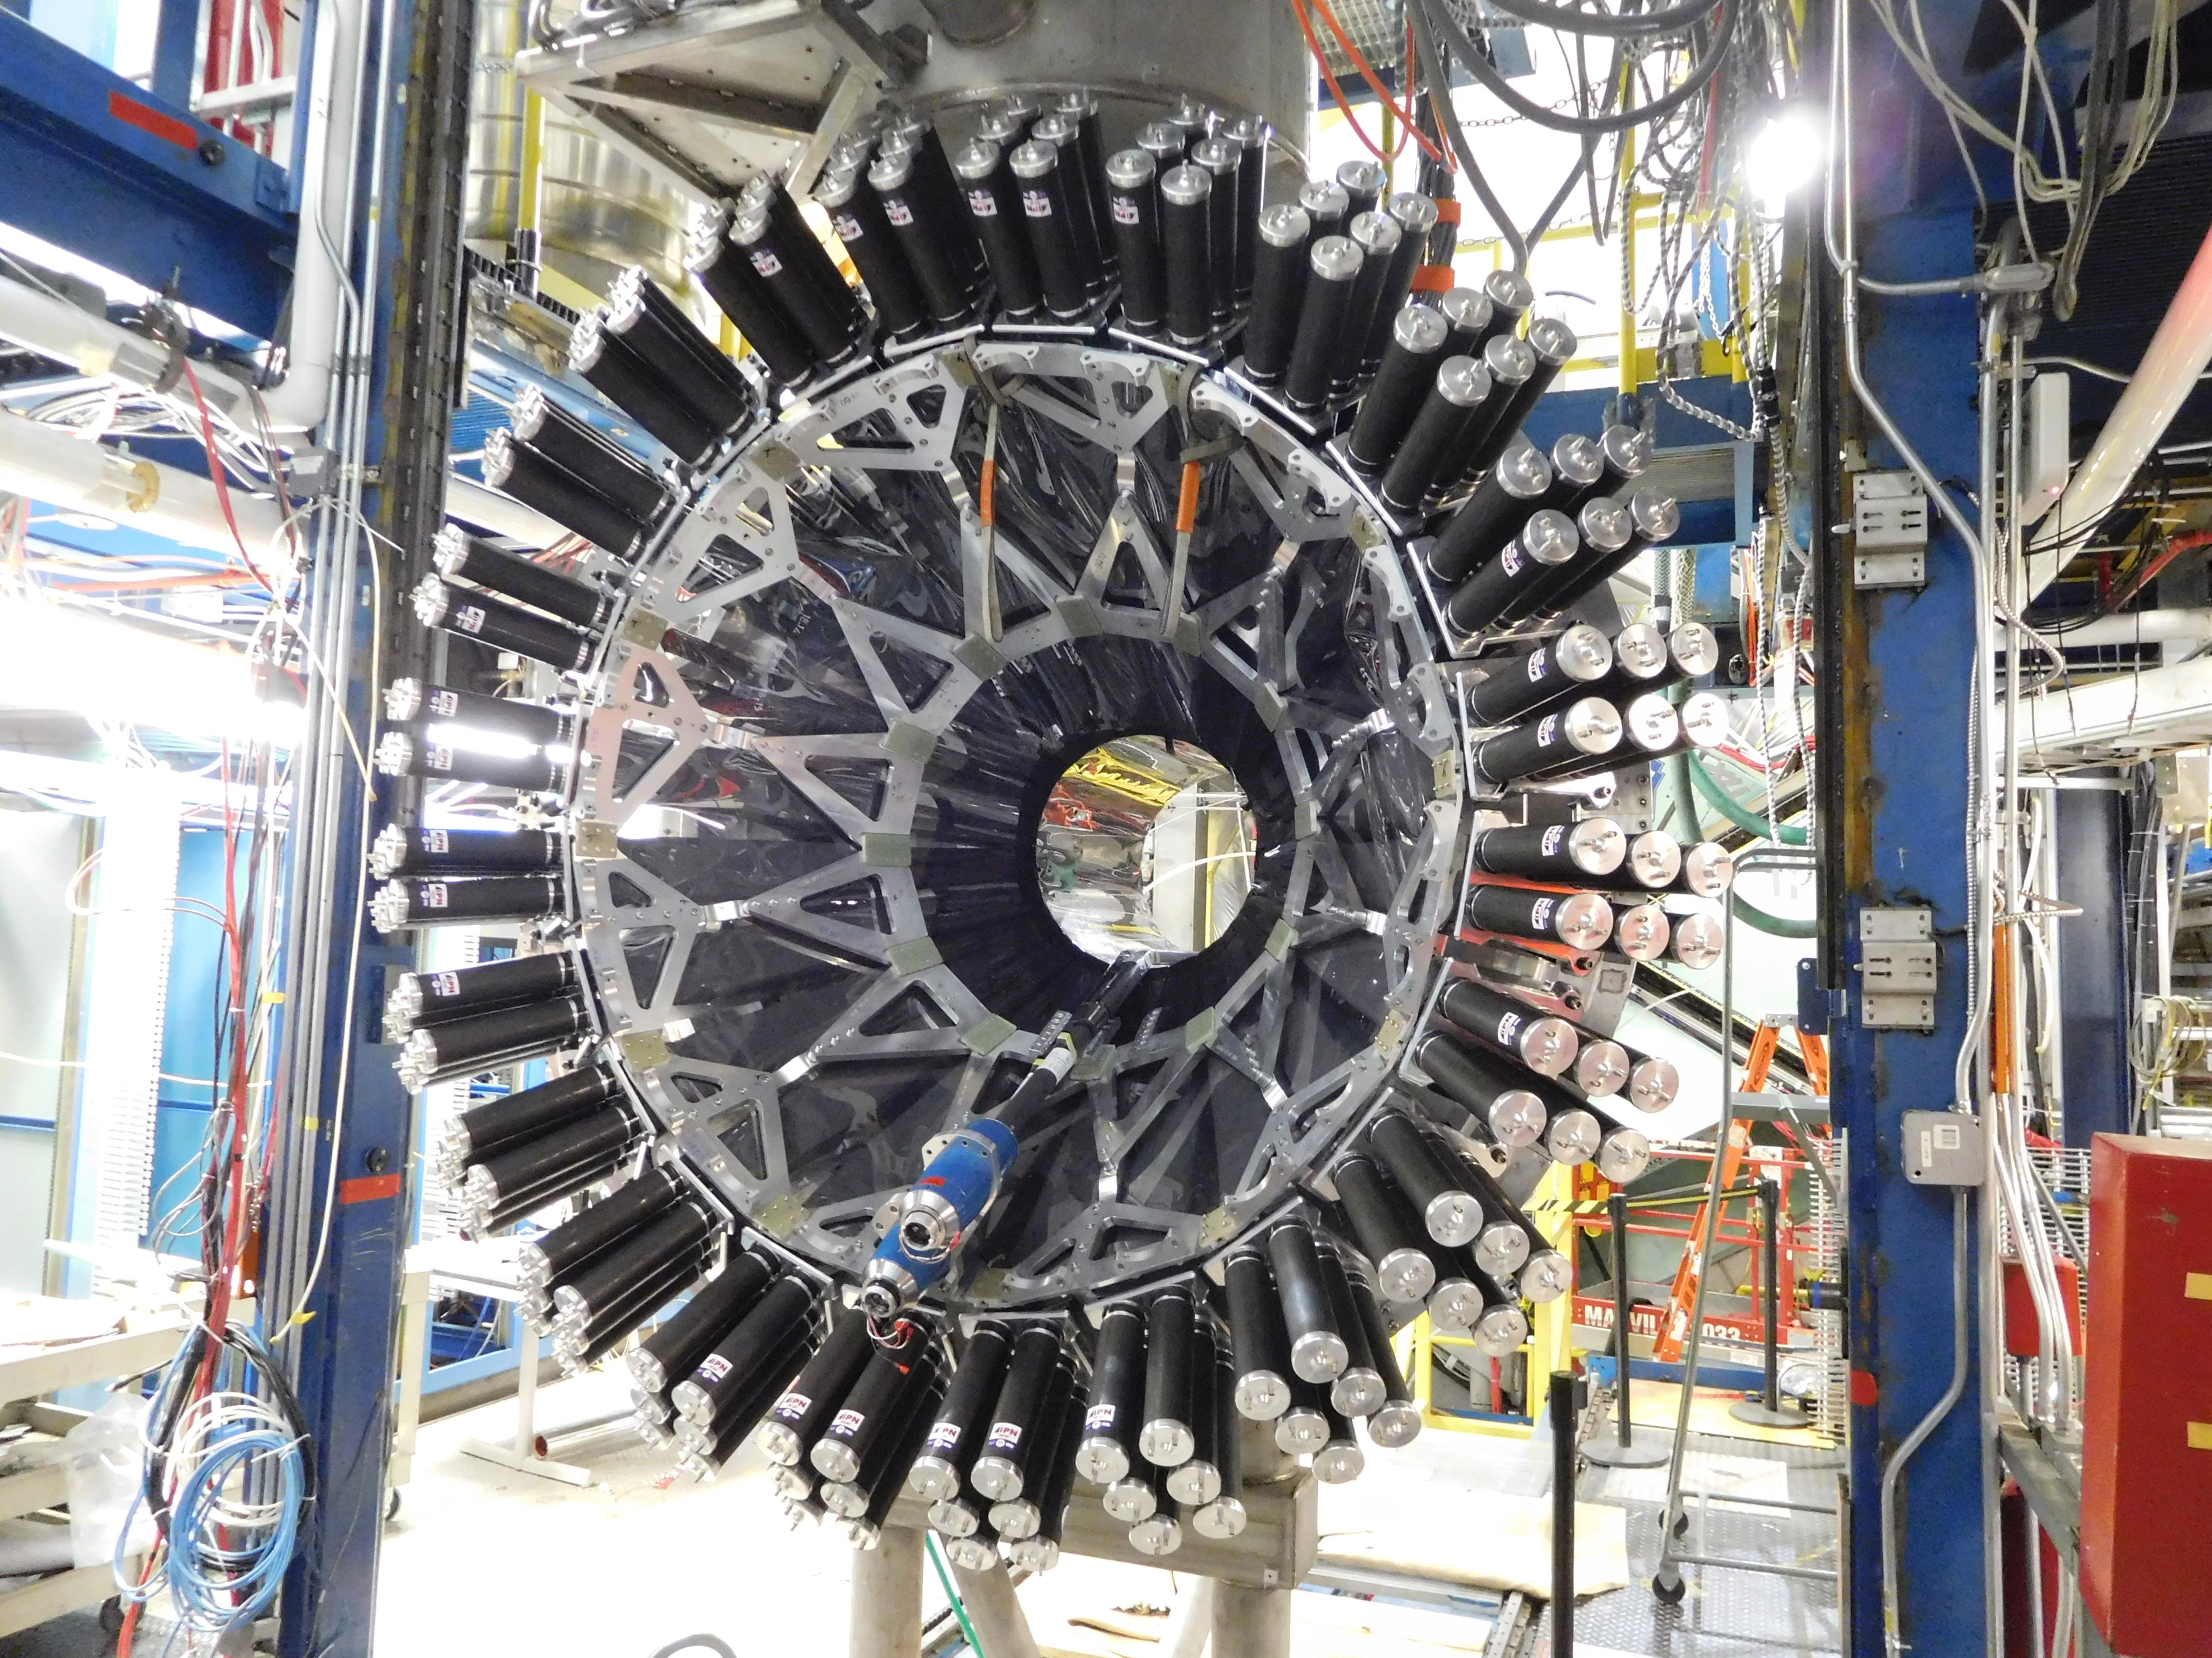
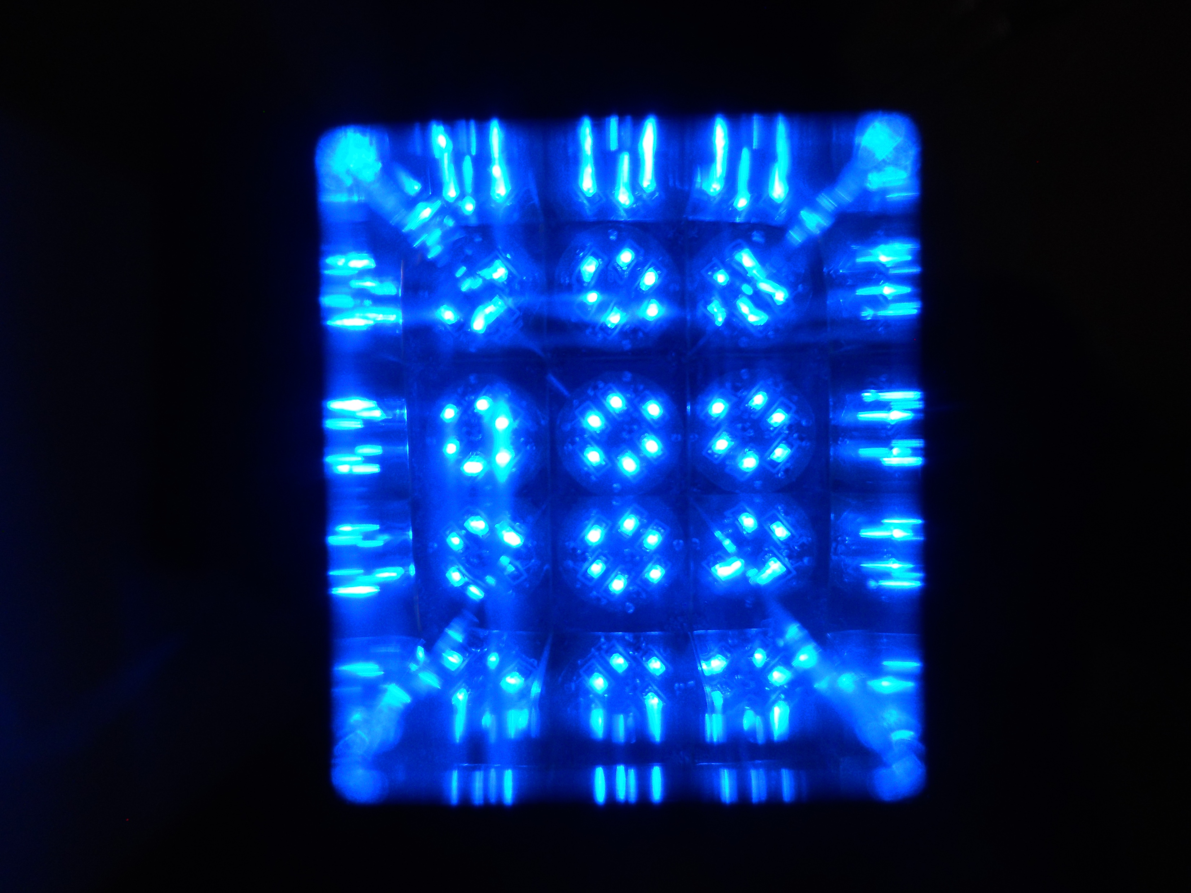
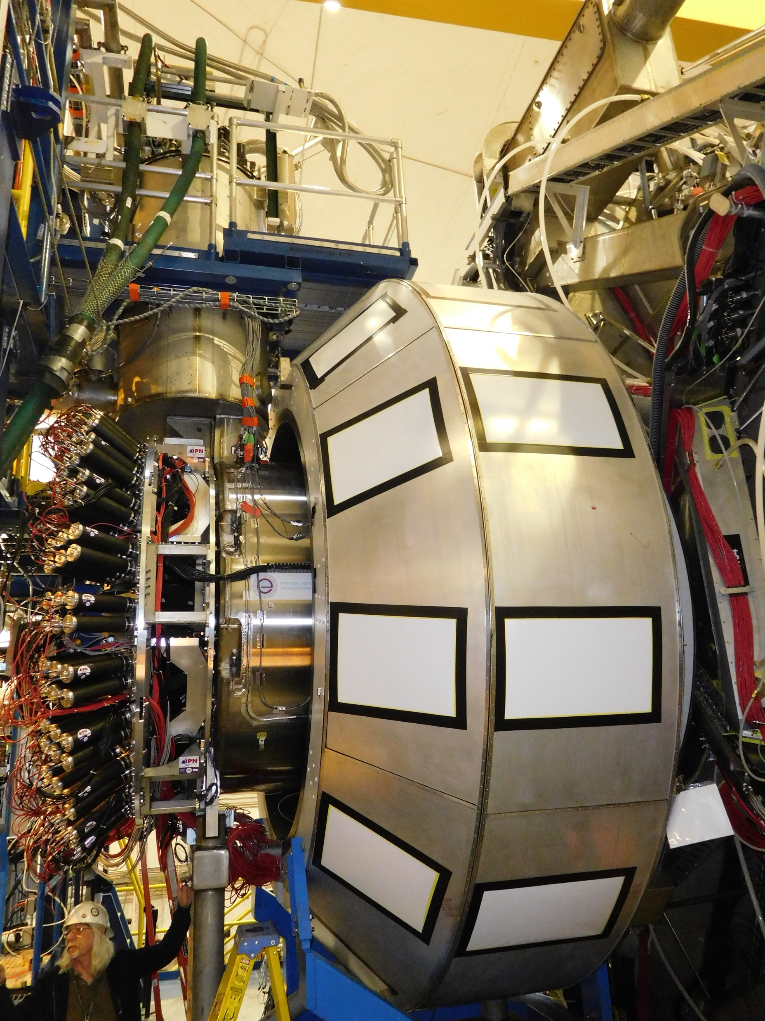
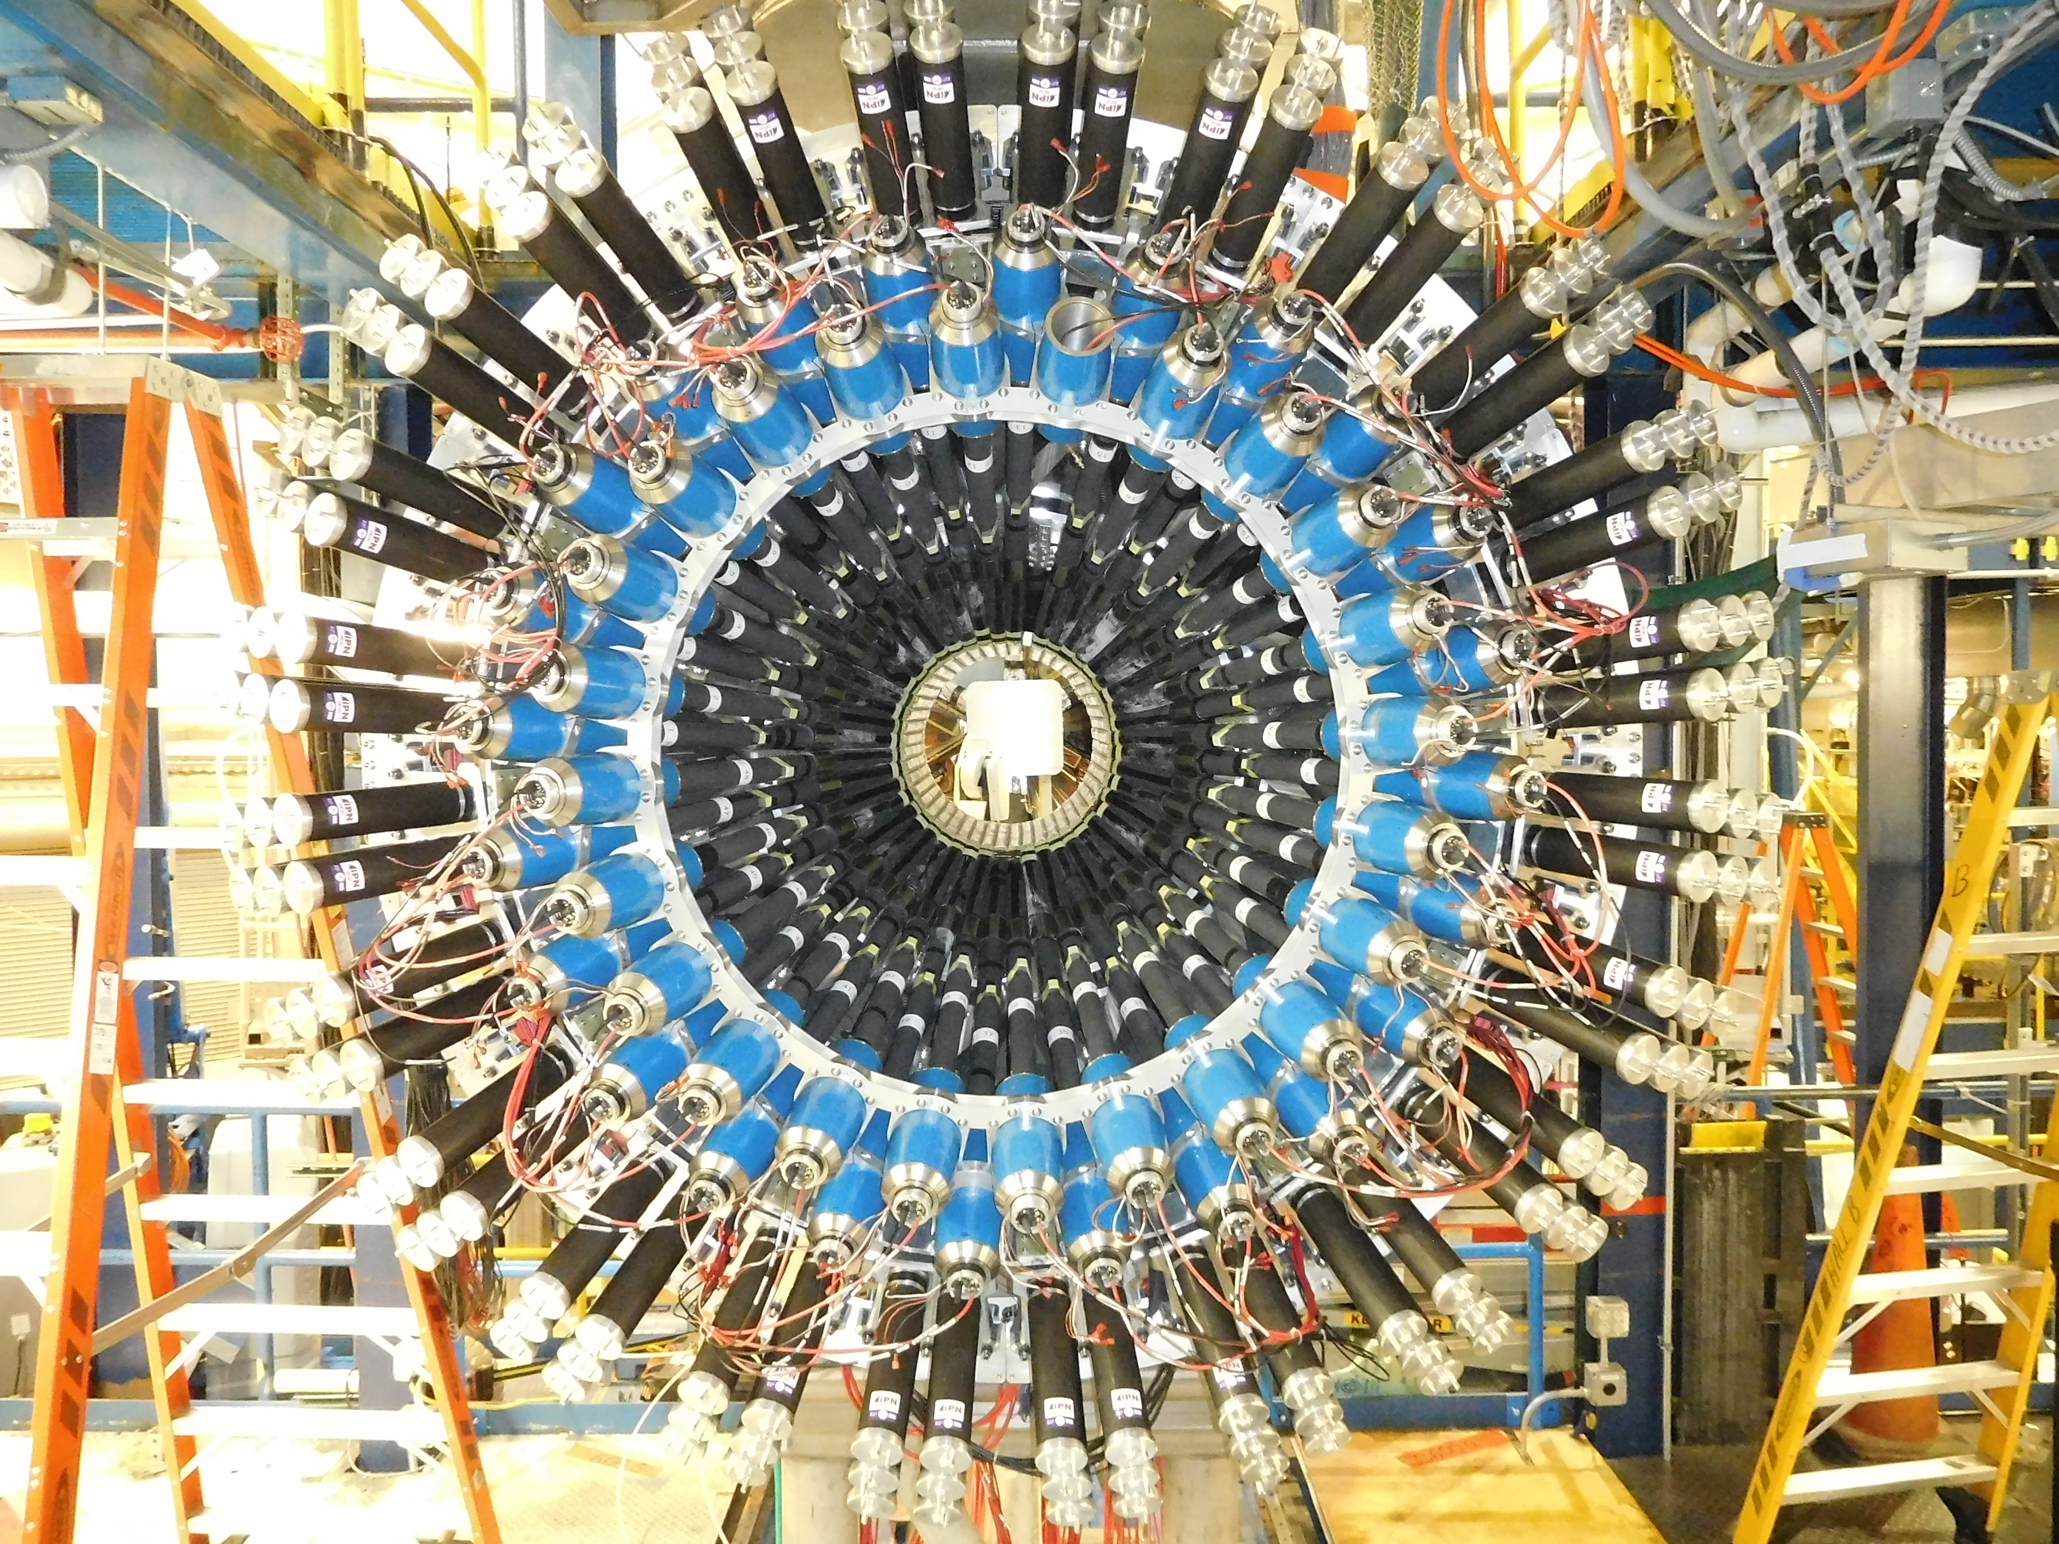
Central Time-of-Flight (CTOF)
Thomas Jefferson National Accelerator Facility
What is it?
CTOF In Action
The Central Time Of Flight is used to determine:
the precise flight time of passing charged particles;
the types of charged particles (pions, kaons, protons, etc.).
When charged particles cross paddles they cause the special material to emit light. We call this process a “hit”. The photons are collected at each end by light guides that channel them to photo-multipliers, connected to computers.
Dedicated software then calculates the position and time of the particle hits, and based on this information we can distinguish the particle types.
A representation of a single collision event taken in April 2018.
We collect about 10000 of these events every second.
You can see the particles hitting various detectors, including the CTOF, highlighted in cyan color.
The CTOF signal allows us to determine the type of each of these particles.
The software suite that we use to monitor the CTOF hardware. Various quantities are plotted versus the channel number. Can you spot the one counter with an issue?
PIONS
The engineering design of the CTOF system. The light from the straight paddles is collected with light guides to sensitive photo-detectors in lower magnetic field regions where they can be processed by the computer electronics.
The CTOF magnetic shield: Capable of reducing the magnetic field in the region of the photo-detector by a factor of 10000.
Top: engineering design and Bottom: after construction.
Tech Specs
PROTONS
48 counters (96 readout channels)
Double-sided readout via R2083 Hamamatsu 2-in PMTs
Counters ~3 cm x 3 cm x 1 m, wedge-shaped design
Acrylic light guides (1 m and 1.6 m long)
Triple layer passive magnetic shield with active compensation coil
Timing resolution ~70 ps
Position resolution along counter ~1 cm
Angular Coverage: Polar: 35º-125º; Azimuthal : -180º – 180º
Time resolution measurement of one CTOF channel: 0.106x10⁻⁹ seconds. That means we can distinguish events in time to within 1/10 of a billion of a second.
Hello particles! This plot show the relativistic speed versus momentum of the particles hitting the CTOF. Thanks to CTOF, we are able to differentiate between protons and pions.
Building and Installing the CTOF
Did you know?
Weight of one counter: ~7 lbs
Weight of one complete magnetic shield: ~50 lbs
A particle crossing one paddle releases around 4000 photons. Usually just a small fraction of these will be collected to the electronics, but JLab’s light guide design is able to collect one third.
The light produced by crossing particles bounces across the scintillator and light guides around 20 times before reaching the electronics.
The average CTOF resolution is 70 picoseconds. This is more than ten millions time more accurate than professional sport stopwatches capable of measuring milliseconds.
Best in class: The CTOF magnetic shields reduce magnetic fields interference by a factor of 10000.
Close-up view of counter assembly to prepare the gluing of the scintillator bar (bluish in appearance) with the Acrylic light guide.
View at the end of the light guide of a small light source placed at the opposite light guide.
The scintillator bars had to have perfectly smooth surfaces. Here a technician works on sanding and polishing of one of the CTOF scintillator bars.
The CTOF counters were installed into the 5-T solenoid magnet one at time, starting at the bottom. This photograph was taken after the first two counters were installed.
Outside the shield
Inside the shield
Outside the shield
Best in class: the attenuation factor of the CTOF shields. Outside the shield the magnetic field is about 1,000 Gauss. Inside the shield, in the middle, it is reduced to about 0.1 gauss. This is a world record for magnetic field attenuation for this kind of compact. design.
As a reference, the Earth magnetic field is ~0.5 Gauss.
Contributing Institutions
Jefferson Lab, Newport News, VA, USA
Kyungpook National University,
Daegu, South Korea
Side view of the solenoid in its final operating position in CLAS12 with CTOF installed inside.
View of the upstream end of the CTOF showing the magnetic shields (in blue) after installation and cabling.

